Slide 1
Dr. Leticia Henderson Baker
Assistant Professor,
Psychology

Slide 2
Mental Health Disparities in the African-American Community
The effect it has on the minority student’s academic success and overall well-being
Project Description:
This project seeks to address the known disparities in mental health care in the African-American community. Mental health forums will focus on mental health issues specifically affecting the Black community including: destigmatizing mental health, dealing with depression and anxiety, accessing affordable mental health services, developing effective coping skills.
Rationale (the WHY):
“Racial/ethnic, gender, and sexual minorities often suffer from poor mental health outcomes due to multiple factors including inaccessibility of high-quality mental health care services, cultural stigma surrounding mental health care, discrimination, and overall lack of awareness about mental health.”
-Mental Health Disparities: Diverse Populations (n.d.) American Psychiatric Association.
1 in 3

Slide 3
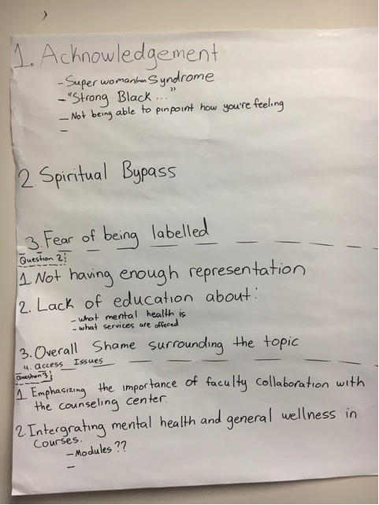
Design Thinking Session April 19, 2022
Capstone Results

Slide 4
Projected Programming for Fall 2022
Monthly speaker forums (September – December)
Goals of forums:
Address the stigma of mental health
Increase knowledge regarding mental health disorders most diagnosed in minorities
Increase knowledge regarding available resources and access to mental health services
Collaboration with campus resources (Counseling Center, Learning Commons, etc.)
Integrating mental health and general wellness into courses
Notes:
It is impossible for a regional economy to achieve transformation unless there is a shared regional identity and a shared vision for regional economic growth that all the partners own – both as collective and individual partners. Partners will need to align the strategies and resources of their own organizations and systems to the regional vision.
The development of a regional identity (which is not necessarily a brand, but it can be) and the vision for regional economic growth are critical to sustaining a globally competitive region.
The vision is especially critical to driving new regional behavior and is the touchstone when a region faces challenges – something that is almost guaranteed given the wide array of interests that are represented in a regional economy.
The vision is also the driver for regional strategies and new investments, as well as for alignment of current investments.

