Slide 1
Dr. Nick Vick
Director, Learning Commons and Honors Program

Slide 2
Academic Success Coaching 2.0
Strategic caseload management
Incorporate high, medium, and low risk indicators
Established targets and metrics
Streamlined and innovative communication strategies
Targeted text messaging
Early Alerts
Pop up video group
Intervention pathways
Training

Slide 3
Proactive Outreach
Proactive Outreach
Notes:
Rationale: Include data to back up your project rationale and any findings you gathered over the year to support this work (Feel free to use another slide to show the data charts, etc...)

Slide 4
Proactive Outreach
Notes:
Rationale: Include data to back up your project rationale and any findings you gathered over the year to support this work (Feel free to use another slide to show the data charts, etc...)

Slide 5
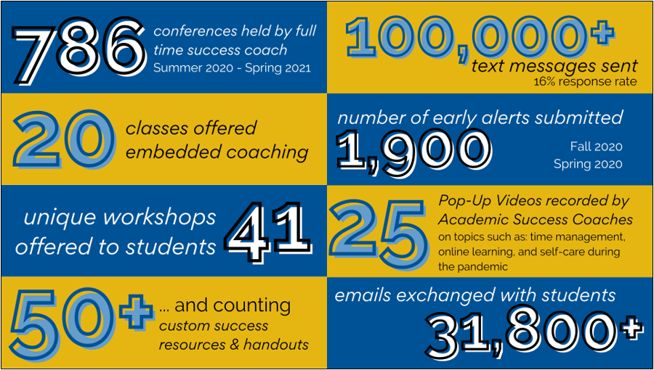
Year in Review
Notes:
Timeline and Expected Outcomes: What do you hope to learn (or have learned) and see as an result of this work?

