Slide 1
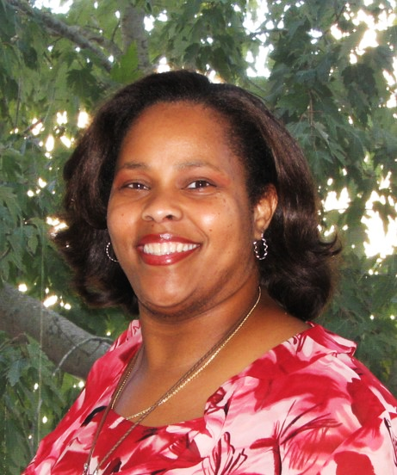
Eileen Durant
Professor and Chair,
Respiratory Care

Slide 2
Capstone Focus
Capstone Overview
Project Description:
Rationale (the WHY):
National organizations support degree advancement
Students are seeking advancement
Community/national need
Open doors for advancement
To design a completions degree for two-year Associate of Science Registered Respiratory Therapists to advance their careers and expand their earning possibilities.

Slide 3
Capstone Results
Interest and Community Need
Required Guidelines State/National
Advisory Board Approval
Development of Courses

Slide 4
SUGGESTIONS FOR FURTHER RESEARCH
Suggestions for Further Research
Complete Course Development
Submit Proposal for Approval
Letters of Supports
Hire Faculty
Seek Accreditation
Notes:
It is impossible for a regional economy to achieve transformation unless there is a shared regional identity and a shared vision for regional economic growth that all the partners own – both as collective and individual partners. Partners will need to align the strategies and resources of their own organizations and systems to the regional vision.
The development of a regional identity (which is not necessarily a brand, but it can be) and the vision for regional economic growth are critical to sustaining a globally competitive region.
The vision is especially critical to driving new regional behavior and is the touchstone when a region faces challenges – something that is almost guaranteed given the wide array of interests that are represented in a regional economy.
The vision is also the driver for regional strategies and new investments, as well as for alignment of current investments.

