Slide 1
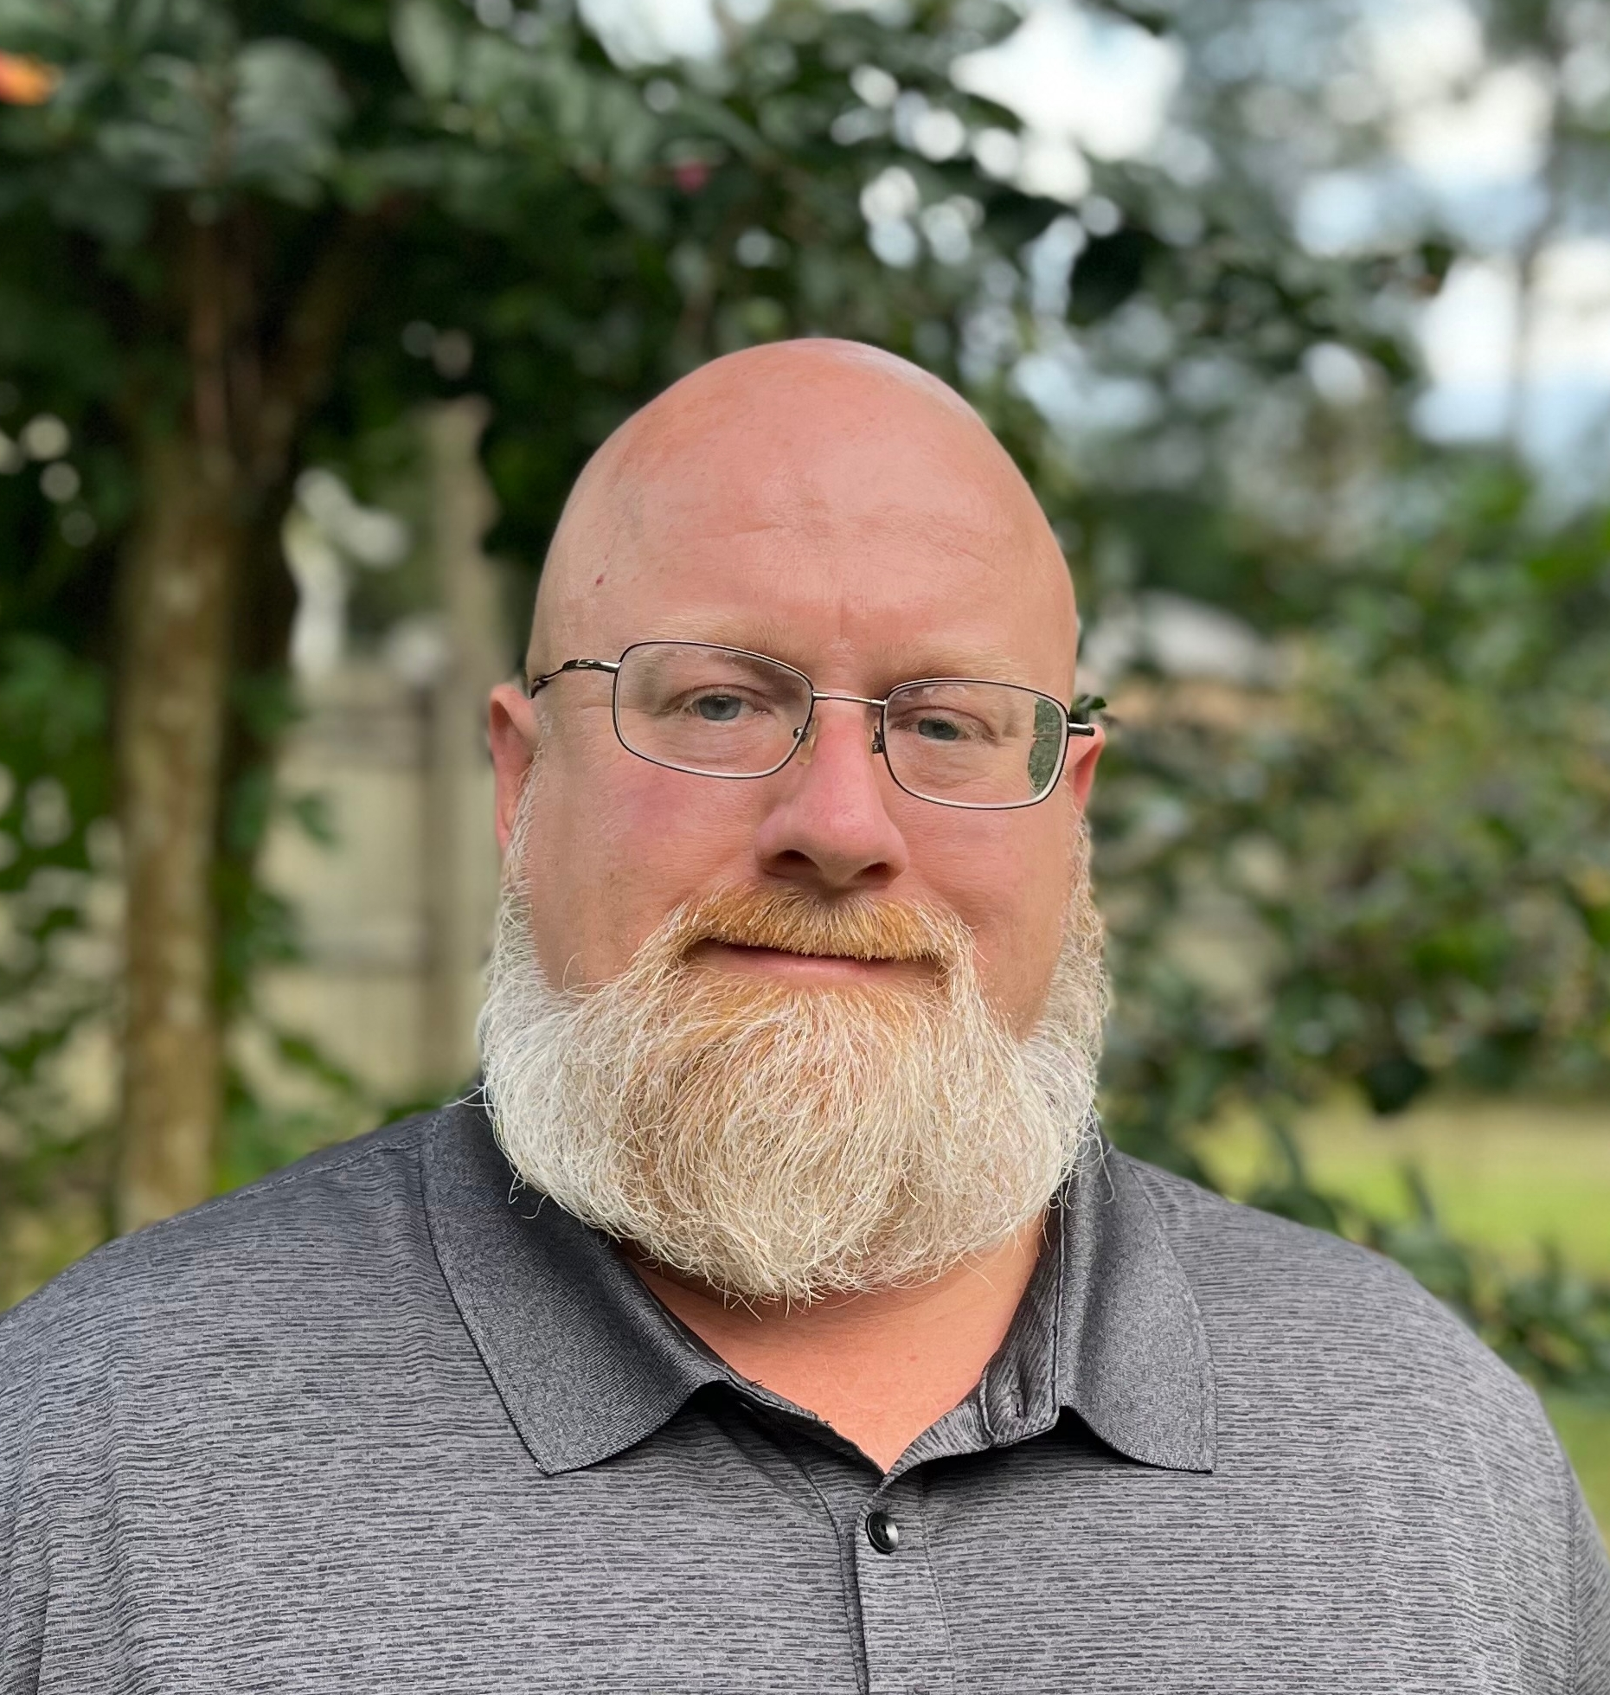
Kris Reeves
Technology Consulting Manager

Slide 2
Capstone Focus
Capstone Overview
Eagle Tech Net
Eagle Tech Net is a digital forum that allows faculty and staff to ask technology related questions and/or request more in-depth help with technology related projects and initiatives that they wish to explore.
Rationale (the WHY):
While searching for a way to introduce of the newly formed Technology Consulting Services group to the campus, I discovered the need for a Faculty and Staff technology forum.
This forum will allow the transfer of knowledge amongst peers, and speedup the vetting and adoption of new and innovative technology.

Slide 3
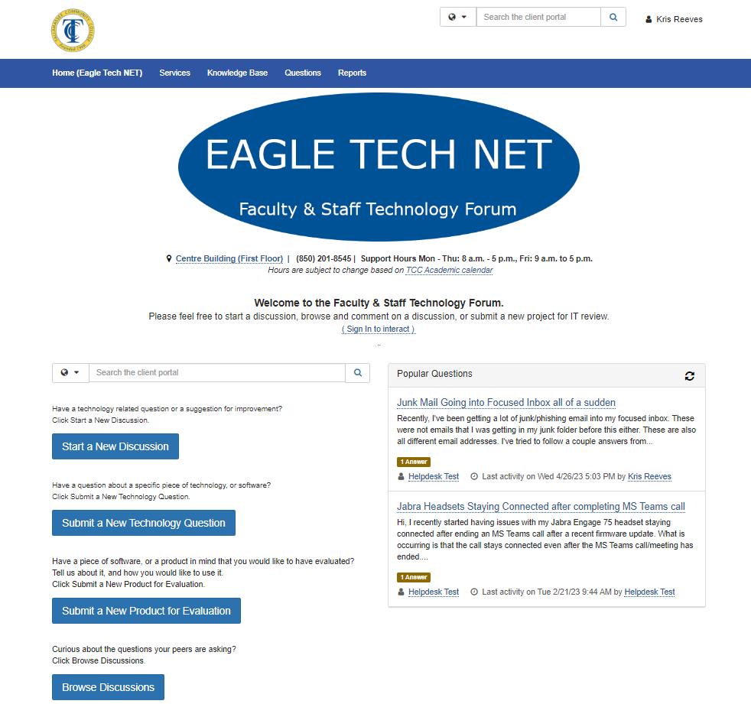
Eagle Tech Net is close to completion of its first stage of development.
Capstone Results

Slide 4
SUGGESTIONS FOR FURTHER RESEARCH
Continuing Development
Eagle Tech Net will allow peer support for technology related questions, foster open discussions about new technology, and make the vetting and adoption of new technology a less stressful more pleasant endeavor.
Phases of development include:
Initial design and testing;
Focus user group testing and feedback; and
Final approval and campus-wide launch that includes demonstration.
Notes:
It is impossible for a regional economy to achieve transformation unless there is a shared regional identity and a shared vision for regional economic growth that all the partners own – both as collective and individual partners. Partners will need to align the strategies and resources of their own organizations and systems to the regional vision.
The development of a regional identity (which is not necessarily a brand, but it can be) and the vision for regional economic growth are critical to sustaining a globally competitive region.
The vision is especially critical to driving new regional behavior and is the touchstone when a region faces challenges – something that is almost guaranteed given the wide array of interests that are represented in a regional economy.
The vision is also the driver for regional strategies and new investments, as well as for alignment of current investments.

